Slide 1
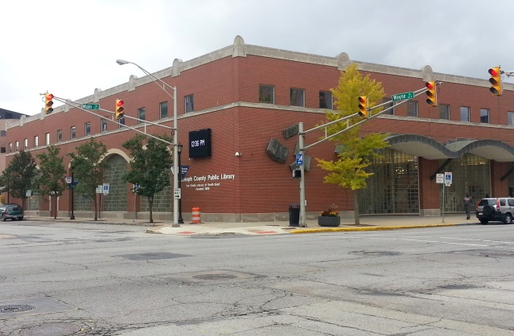
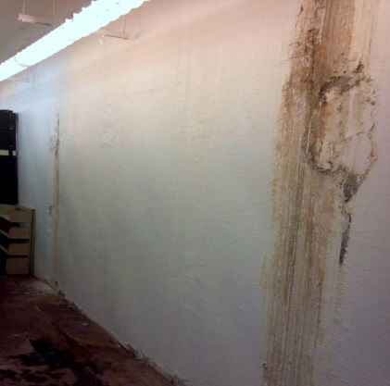
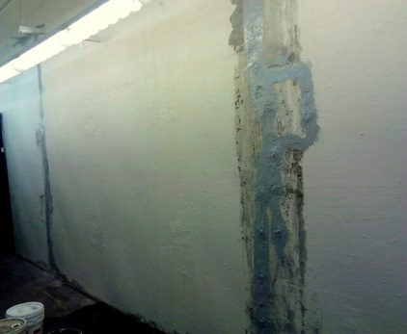
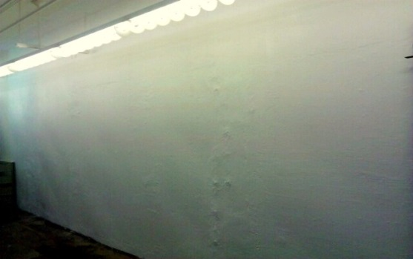
Location: South Bend, Indiana
Engineer: n/a (in-house design)
Solution
3D Structural recommended the Hydrophilic Urethane injection process to seal the more substantial foundation crack lines. After the outer epoxy coatings and injection ports were set and the cracks were injected, the ports and epoxy were removed . Waterproofing compound and vinyl patch mix were used to cover the cover the remaining cracked areas.
The application of the vinyl patch created a flush wall surface suitable for painting and free of obstruction for bookcases and other storage elements.
Results
After the interior wall was painted, the bookshelves and other storage elements were placed back into the area. There have been no recurrence of leaks within the first two years of the repair.
Description
The downtown South Bend branch of the St. Joseph County Library, built in 1998, has a full basement foundation with thickened walls at a height of 10’.
Requirements & Challenges
Small cracks in the foundation wall created issues with leaks during periods of heavy rain and snow melt, causing damage to boxes and other items stored in this area. Being the main branch for the county library system, many of the stored items, books, and other records have historical or other market value.
The SJCL needed a way to waterproof the cracks without requiring exterior excavation, and that would allow for shelving and filing cabinets to be placed directly against the wall without obstruction.

